Slide 1
DAY 1
16:00-19:00
Speaker (Teva Loos?) to include

Slide 2
CHRISTINE

Slide 3
Danone Connections
Christine Gas
Christophe Gillet

Slide 4

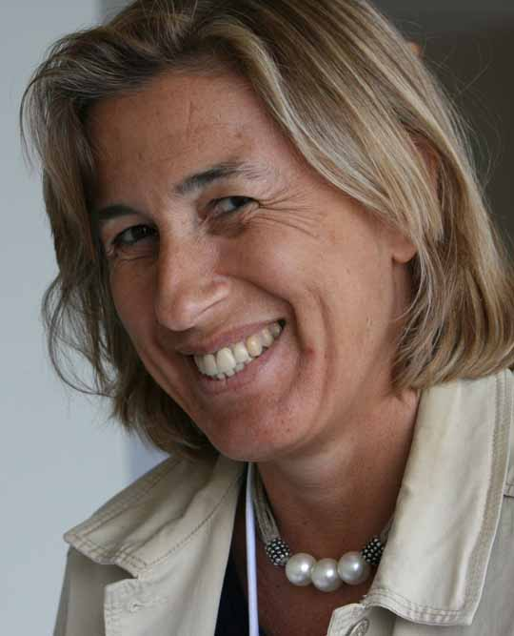
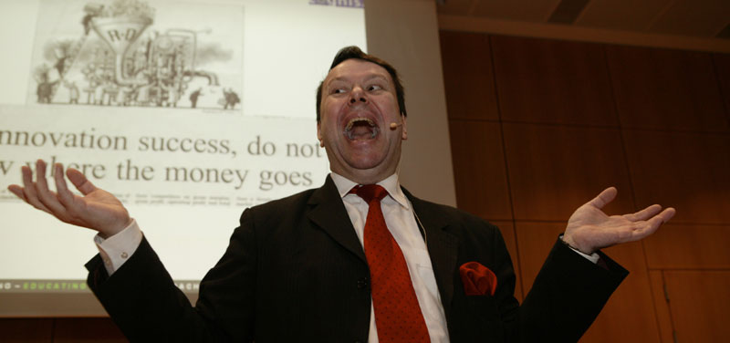
Danone
Connections
Christine Gas
Christophe Gillet
Notes:
Jan Willem’s comments :
As you know, a key part of « People growth architect » is to understand and connect with danoners through team leaders.
I am very happy to welcome Christine Gas and Christophe Gillet who are going to conduct a 3 hours session to present Danone Connections which is a fantastic communication system to help team leaders to engage and empower all danoners and therefore help the CBU to become a great place to grow…
This is a process I fully support and wish it will be implemented in all CBUs
CGas:
Hello to all of you !
I am very happy to be here, my name is CGas, I am Corporate HR and Internal communications at the HQ
CGillet:
Bla bla bla
CGas:
I am very happy to close this first day of the Phoenix HR conference devoted to “people growth architect” with Danone Connections, because definitely, and thank you Jan Willem to sponsor our session, Danone Connections is clearly a simple and concrete mean to contribute to “equip and empower team leaders to engage and develop all Danoners “ especially through communication

Slide 5

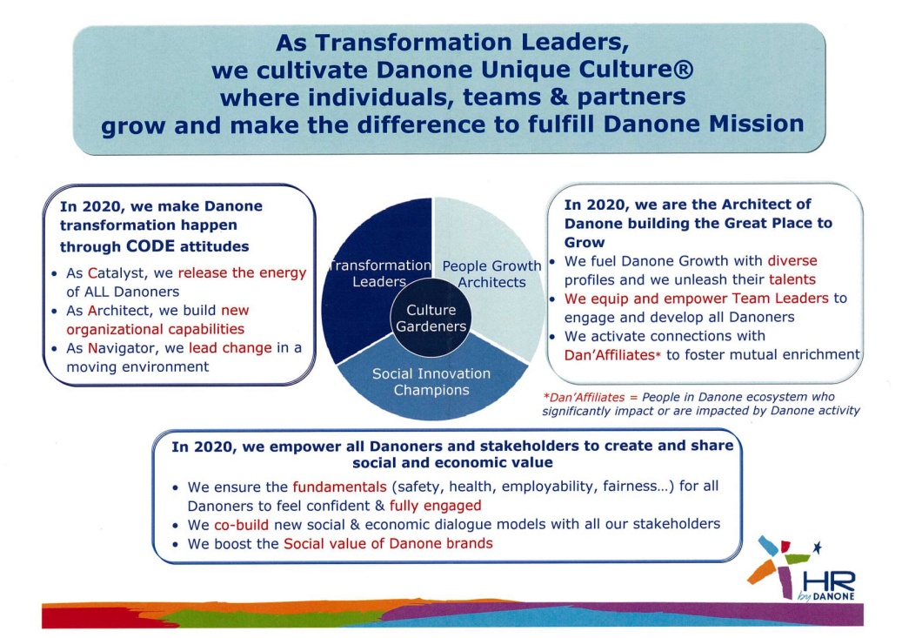
Equip and Empower Team Leaders to engage and develop all Danoners
HR
mission
Notes:
And you remember for those who were at Evian at the HR convention last july, , this document, concerning the new HR vision, was displayed…
….and Danone Connections was selected in the market places as a best practice to engage all Danoners and to align them on the strategy of their CBU.

Slide 6
Why are we here today?
… to learn how to build a sustainable internal communication system in your CBU…
based on Proximity Management through Team Leaders

Slide 7
What is it?
Notes:
DC is a concrete a simple tool to create and encourage regular dialogue with each Danoner through team leaders to provide them with a clear understanding of the business vision and strategic priorities. This dialogue is aimed to take place in monthly meetings where Danoners will have time to express themselves and find the answers to their questions.
DANONE CONNECTIONS est une démarche de communication interne, dont l'objectif est d’équiper le manager de proximité afin qu’il puisse jouer son rôle de relais de la stratégie le plus en confiance possible, et créer ainsi au sein de son équipe l’échange, le dialogue avec la finalité d’aligner toutes les équipes sur la stratégie et de développer leur engagement.

Slide 8
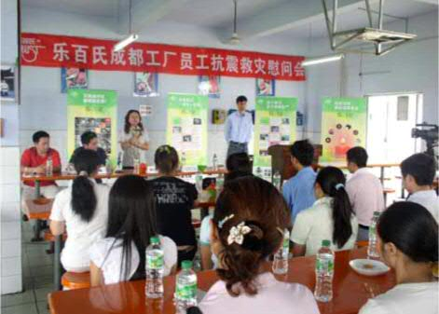
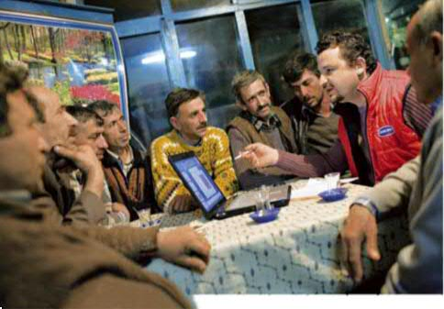
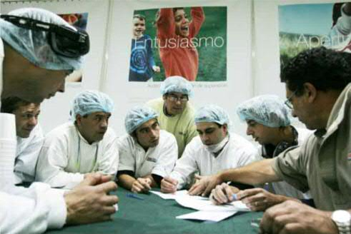
Why Danone Connections?
Notes:
To be consistent with our HR policies… !!... As we all know they aim to enhance business performance as well as to help individuals progress…
Internal communication is key in the process, you all know that the ambition of internal communication is to be a key business lever through the engagement of all Danoners and their alignement on the strategy of their CBU. Danone Connections is a great tool to achieve this objective
Having internal communication in your scope (in almost all CBUs), you have a key role to play on this matter

Slide 9
Objectives of this session
Be part of it!!
Notes:
We have 3 main objectives in these 3 hours:
-To show you that Danone Connections is a driver of employee engagement, therefore a business lever because it gives sense to their day to day work.
Besides it is consistent and complementary with the Danone leadership college , giving a concrete application of proximity management and CODE leadership on the field with the Danoners
-To give you the elements to convince your GM and CODI that cascading their strategic messages through Internal Communicators to all danoners in the CBU will help to grow the business . Danone connection is in the heart of the process
-Now that you know what DC is about, my 3rd objective is that you be part of it… and great support!

Slide 10

Do you
really know the world?
Do you really know the world?
Notes:
Before starting, let’s check this out…. Let’s see how the world is today in terms of communication…

Slide 11
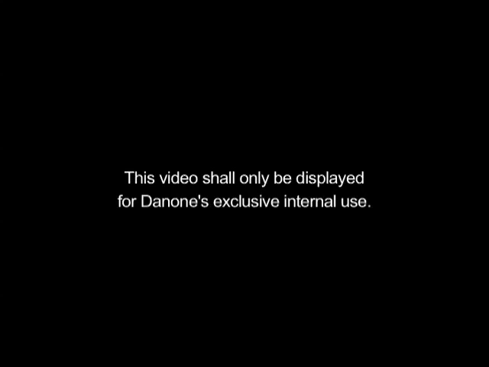
Notes:
Before starting, let’s check this out…. Let’s see how the world is today in terms of communication…

Slide 12

What do
Danoners
Want?
Danone People Survey
selected statements
Asia - Pacific
Notes:
Here we are. The world has changed and we need to take that into account.
The first thing we must do before communicating is listening, getting feed back…
Therefore I went through the Danone people survey 2009, with a focus on the results of the Asia-Pacific zone. I was wondering ,what do Danoners want ?
And I found some interesting results that I would like to share with you today. Here is a selection of statements to illustrate in a concrete way those results : let’s discover in 5 items what really want the Danoners.

Slide 13
“I think my company is lacking effective communication between the different departments …”
“Routine meeting (formally or informally) with other departments
to update issues & increase teamwork”.
More
Dialogue
China
Indonesia
Notes:
Thanks to the DPS Danoners demand more dialogue …. they want to increase the team work

Slide 14
More
Proximity
“Improve communication / relationship
between company & employee”.
Indonesia
Notes:
There is also a demand of more proximity… tho improve the communication between managerial levels of the company and Danoners…

Slide 15
More
Leaders
“Change the mindset! Good and effective communication from management by giving a real example from themselves”
“Improve the leadership of middle management”
Indonesia
Notes:
Danoners want to see the example coming from their inmediate management. Danoners want more Leaders that give real example by themselves providing good and effective communication…

Slide 16
The
Big Picture
“To have better communication on the
development and activities that the companies are doing from time to time.
Have regular updates on CBU or Danone Group activities and development”
“Communicating to employees clear vision &
goals of the company in coming 3 years”
Malaysia
Saudi Arabia
Notes:
Danoners want to know what we call ‘the Big Picture’, they want to be updated not only about the activities of their CBU, but more and more they are interested on knowing the incoming projects of the group. They want to share Danone vision and goals for the future!

Slide 17
More
Engagement
“Involvement of shop floor on a daily basis. Line is not stopped for meeting which is
essential to improve productivity and
two way communication”
Malaysia
Notes:
Danoners want to be engaged! Danoners from all levels want to be involved in ‘all that is happening in Danone’. Teams are exhausted. It is necessary to communicate on the quick wins, and make people willing to become their brands ambassadors outside of the office building, through communication.

Slide 18
ASIA PACIFIC ALL WWBUS
ASIA PACIFIC ALL WWBUS: WATERS
ASIA PACIFIC ALL WWBUS: DAIRY
ASIA PACIFIC ALL WWBUS: CORPORATE
ASIA PACIFIC ALL WWBUS: BABY
ASIA PACIFIC ALL WWBUS: MEDICAL
# Category A B C D E F
Notes:
In terms of quantitavie results, we see big gaps among WWBUs…… if water is above the average, dairy and baby are significantly below…

Slide 19
ASIA PACIFIC
ASIA PACIFIC : MANAGERS
ASIA PACIFIC : NON-MANAGERS
A B C Gap of
Dairy
23
5
16
11
Waters
Baby
Medical

Slide 20

INFORMATION
LEARNING & DEVELOPMENT
PAY & BENEFITS
REACTION TO SURVEY
MY JOB
EVALUATION
COMPANY IMAGE
ENGAGEMENT
CULTURE & VALUES
LEADERSHIP
ORGANIZATIONAL EFFICIENCY
IMMEDIATE MANAGEMENT
CSR & ENVIRONMENT
Asia Pacific (M) 2009 (1175)
vs.
HP Mgt Norm (137488)
Notes:
As a whole, on 3 very important categories: Engagement, Leadership and Inmediate Management, the zone Asia-Pacific is significantly behind the High Performance Management norm…

Slide 21
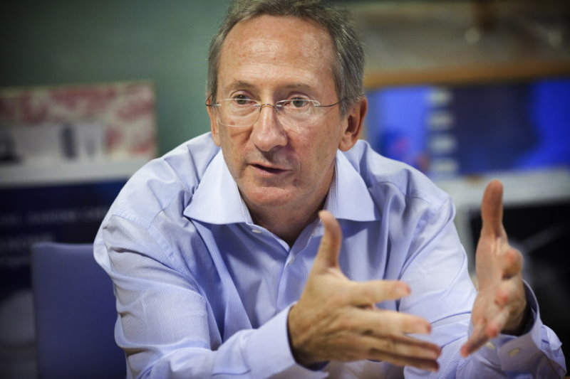
We need leaders!!
“Internal communication in essential in order to engage and empower our 80,000 employees” F. Riboud
Notes:
2 years ago at the GM meeting in Evian Franck RIBOUD explained his vision of internal communication.
He has very clear ideas on what is a leader…. We have 80 000 employees to engage and 15 000 team leaders that will do the job.
Let’s listen to him.

Slide 22
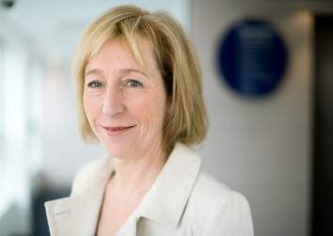
We will empower leaders!!
“Embarking all Danoners (…) is our major commitment. I expect anyone who manages a team to be a leader and to engage each of their members individually and collectively” M. Pénicaud
Notes:
Muriel Penicaud, in the Social and Economic Report of 2008, highlited the importance of embarking all Danoners through team leaders.
** Let’s not forget the context in 2008, a time of crisis, when, more than ever, the performance of Danoners reflected the performance of the business.

Slide 23
Proximity Management
Notes:
and 2 years later, it was in july this year, Franck Riboud and Muriel Pénicaud insisted again won proximity management.
More than ever, proximity management to achieve employees engagement is essential to reach CBU business priorities.

Slide 24

Sharing the vision
Giving sense
Connecting to their mission
15,000
Team Leaders with CODE
Listening with empathy
Having proximity in all levels
Creating dialogue
Engaging teams
Motivating people
Speaking up
Getting involved with their projects
« Big picture & Hands on »
Notes:
Danone Connections will help team leaders to show their CODE attitude to their team because to implement Danone Connections, means « being CODE »:
COMITTED: - Share the vision
- Give sense (create a sense of purpose for teams)
- Being connected with the mission of the company
OPEN: - Listen with empathy and at the same time encourage straight talk
- Interact with proximity in all levels
- Create dialogue, connect → develop authentic relationships
- Bring a business culture
DOER: - Speak up! Communicate!
- Being engaged with their projects,
- Able to swith between the « big picture » and hands on approach
EMPOWERING/EMPOWERED: - Engaging and Aligning the teams to a common vision & ambition
- Motivate them
- Encourage them to work hard

Slide 25
DAY 2
9:00-18:00
Speaker (Maire?) to include

Slide 26
CHRISTOPHE

Slide 27
The Activation Session
What do we expect your IC to do …
Notes:
CHRISTOPHE GILLET PRENDRE LA PAROLE !

Slide 28

Why Change?
The Activation
Session
Notes:
-WHAT TO CHANGE TO?-
[1- Prepare your worst communication experience – within Danone]
Tell your story…

Slide 29


© Gillet – Pentacle 2008
P R O V O K I N G – I N S P I R I N G – E D U C A T I N G – E N A B L I N G - F A C I L I T A T I N G

Slide 30
The way you communicate
The way YOU communicate
Notes:
-WHAT TO CHANGE TO?-
Leave a short silence after the video finishes… (time for the audience to let their emotions flow)
It's all about People
It's all about Communications
It's all about Danone

Slide 31
Notes:
Before starting, let’s check this out…. Let’s see how the world is today in terms of communication…

Slide 32
90 minutes Activation session
Team Leaders Activation Session, by IC

Slide 33
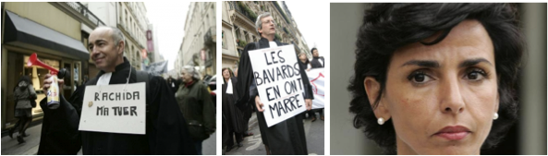


WHY CHANGE?
WHAT TO CHANGE TO?
WHAT TO CHANGE?
HOW TO CHANGE?
Explain the context
Engage
‘What’s in it for me”
Explain the Concept
Explain the Toolbox
Explain how we’ll collaborate
Explain the problems
we tackle
COMMUNICATE TO ENGAGE
COMMUNICATE TO INFORM

Slide 34

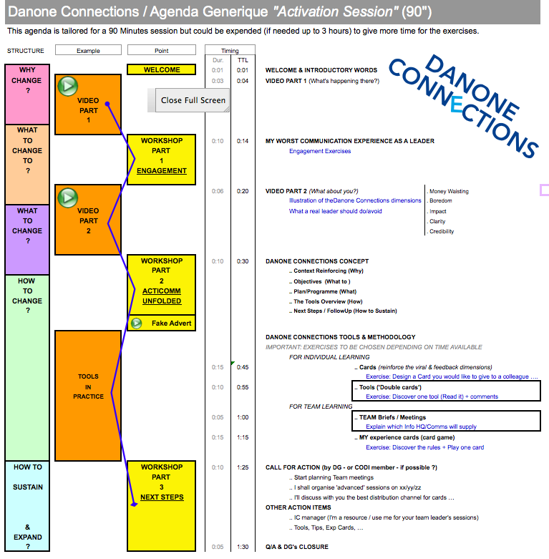

Slide 35



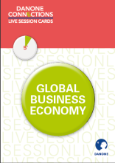

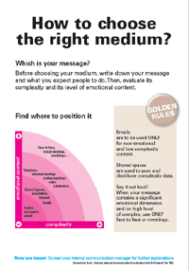
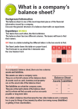

Danone Connections Kit
+
Communication
kit
Notes:
Earlier Christophe showed you the toolkit aimed at helping your team leaders communicate.
But among all the tools designed we wanted now to focus on the main support your team leaders will rely on every month to animate their Live Session : the communication kit.
This is the document that YOU will provide to your team leaders.
So what is the Communication kit and what does it consist in?

Slide 36


Danone Connections TIPS
Notes:
-HOW TO CHANGE?-
[1-Choose in advance the Tip you’d like to present]
[2-Have one in your hands when you talk, show it while you talk / Prepare several copies of several cards to be distributed with the coming exercise]
This document, that we call a ‘Tip’ is a card that will be openly available to all, and to all Danoners at public spaces inside Danone, like canteen, etc …
It is a viral, mass market product.
Each of them gives, with humor, a simple lesson about how to improve individual communication…
They can be used to give a funny feedback, or be sent to a colleague, etc…
Let’s explore one into detail ….
[3-Read the front of the Tip (the catchy phrase) and then give complementary information by reading the quotation or statistic written on the back]
[4-Print some blank tips in a bigger format (ideally A3) and distribute one per person. Give them markers and make them create their own tip; afterwards, read them all aloud]

Slide 37
Danone Connections
TOOLS
Notes:
-HOW TO CHANGE?-
[1-Choose in advance the Tool you’d like to present]
[2-Have one in your hands when you talk, show it while you talk. Prepare several copies to be distributed with the coming exercise]
This document, that we call a ‘Tool’ is proposed for deeper self learning on a more sophisticated communication topic.
Each of these Tools will be made available to all Team Leaders.
Let’s explore one into detail ….
[3-Distribute some tools in 2 or 3 teams, give them time to read the tool and then ask them to explain each tool to others]

Slide 38

Danone Connections
TOOL
EXAMPLE
Fresh Fish Sold Here

Slide 40
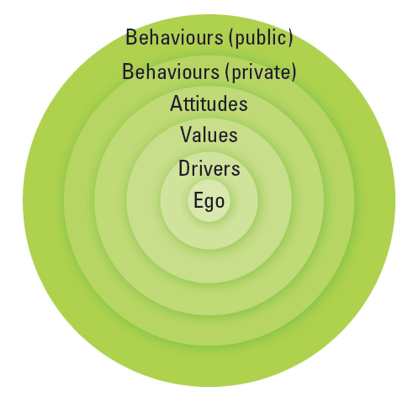
The human onion
Danone Connections TOOL
EXAMPLE

Slide 41



…………....
…………....
……….....
……….....
……….....
……….....
What’s the Communication Kit?
Every
month
PPT
Information
Confidence
Team Leader
Notes:
As I told you before, the Communicatoin Kit is the back bone of the process.
It is a Powerpoint document, summing up the key messages defined by the CODI.
It is sent every month to team leaders to help them animate their Live Sessions.
It is aimed at giving Team Leaders key information and confidence when animating Live Sessions
What does-it look like ?

Slide 42
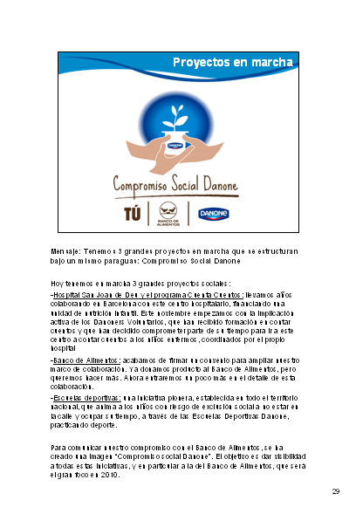
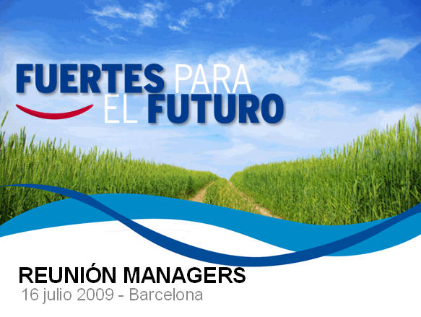
Support for
Monthly
“LIVE SESSIONS”
Team Dimension
Notes:
-HOW TO CHANGE?-
Let’s move on now to the Team dimension.
In order to engage and develop teams, what do you think we need?
(Let a few seconds for reflection)
A relevant content, information, etc …
A way to engage all members of the team.
The CODI has agreed on defining the messages to cascade after every CODI meeting. You will then receive a rich communication kit (power point presentation, short films…) which will help you to keep your team updated on the business news through a monthly (45’) “Live Session”.

Slide 43

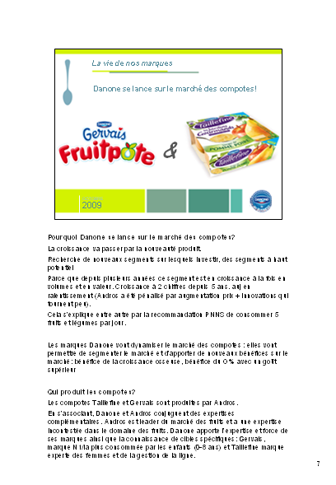

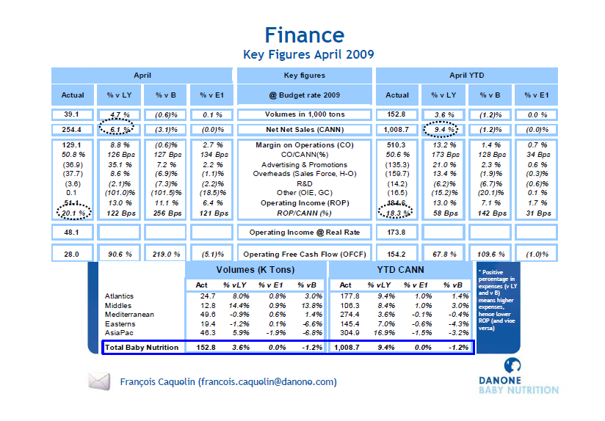
x
A relevant format
Notes:
1) It must be « presentation friendly » :
Accordingly to the tricks Christophe gave you before (fresh fish sold here : kill the useless words / 5x5 rule / don’t compete with your slides / sexy titles and impactful image)
Clear,
Spaced out,
Use all the media you may have : videos, photos, figures…
and the information has to be simple. Don’t put complicated boards, or not understandable schemes. Simplify the message in order to make Danoners understand what it means, and to make your team leaders at ease with it. Indeed, they need to feel comfortable, and to take a hold of the support.
I insist on this point because mainly, Team Leaders are not keen on communicating to their teams when they don’t have the answers. They fear being trapped and not having the answer.
2) Thus, and above all, your communication kit is not only composed of mere slides. It is completed by large speaker notes that develop the slides content.
You can also add to the Communication Kit a brief gathering Q&A. The objective is to think of the questions the Team Leaders may have and to provide in advance the answers. You can send the brief to them or organise a live brief, to present the kit and its content.
Once more it gives confidence to the Team Leaders to feel they have to key to reply to their teams.

Slide 44
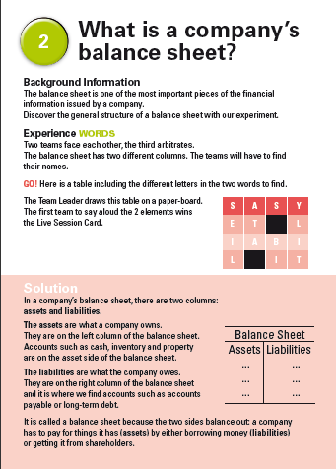

Danone Connections LIVE SESSION CARDS
Notes:
-HOW TO CHANGE?-
[1-Read in advance the instructions of the Game and choose the Live Session Card you’d like to present and play with]
The Danone Connections “Live Session Cards” have been created to support your business talk. They aim to help you and your team discover the basics of economics, the specificities of Danone as a company and our CBU more in detail.
This flexible card game can be played at any moment, whenever you have 5 minutes available. It is highly recommended to play a short session of this game before every “Live Session”.
Let’s play one card…
[2- Follow the instructions of the chosen card and make them play. Take for example the one about Danone worldwide presence:
First explain the background information to all
Then distribute people into 2 different teams
Alternately, every team has 10 seconds to give the name of a country where Danone is established
In a paperboard, write the name of the countries that each team has said to be sure that no country is repeated
Stop the game when the 2 teams have no more proposals
The team with the highest score wins
Read the solution in order to give them more complementary information about the experience they’ve just lived
[3- Distribute some cards to your audience to show them what’s on it. Tell them that the aim is to play one card before every team meeting]

Slide 45
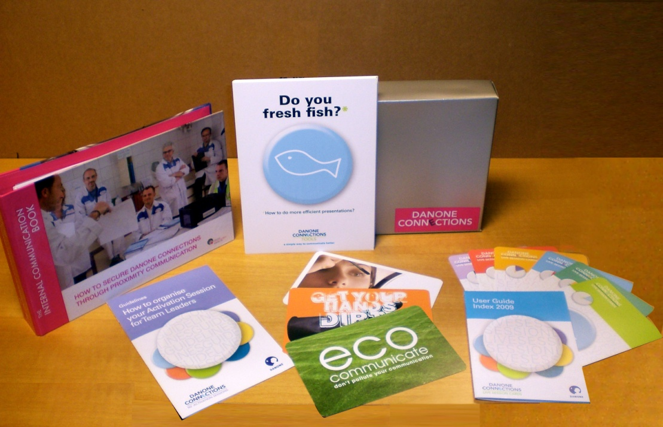
Danone Connections
BOX
Notes:
SS
Now we’ll give each one of you a box, containing the tools we have presented you during the last two days.
I’d like also to attract your attention on a leaflet, recently designed that you can use like a to-do list to organise your Activation Session. It gathers what to keep in mind in order to make of it a success.
You’ll also find what we call “the IC Book”. You will find IC Managers profiles, good practices, and contacts to help you in your daily work.

Slide 46

Call for Action
IC
Notes:
-WHAT TO CHANGE TO?-
And now, what about yours?
Would you please take 5 minutes around each table, to share your own worst communication stories (WITHIN DANONE)?
Give them 5 minutes
Ask each table to share one story (the really worst one) with others ….
Conclude (with a smile):
- It seems that we have some interesting cases here!
- Communication is indeed tough and full of surprises
- Let’s have a look at this video

Slide 47
Q&A
Q/A, Tools, Bible,…
Notes:
Explain all the tools & support available
1) To deliver
2) To prepare
Agenda
Presentation of the support tools
The Bible (quick go-through)
Next Month Objectives (Follow-Up Document)
Explain that now, we enter the PREPARATION MODE ….

Slide 48
CHRISTINE

Slide 49
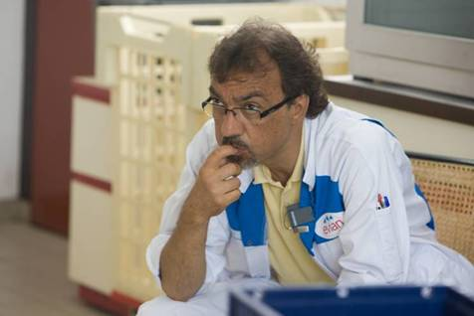
To encourage dialogue
Notes:
Christine reprende la parole!
Today information comes from everywhere: infront of the coffee machine, on the newspapers, trade unions, collegues, internet…. It seems harder and harder to distinguish what is a rumor from what is truth….
People are worried… Some of you have social crisis in their factories… Danoners must find the answers… but moreover, find them within Danone and their managers.
It is the GM’s role to speak up!, to share the vision… to explain, embark, motivate, engage… We have seen what Danoners want… It is clear and necessary! But GM can’t be anywhere, all the time. GM is not a one man show. He needs support, spokepersons / relays that can give the right answers whenever needed and can also collect precious feedback.
So the big question is.. How to organize this dialogue?

Slide 50

Keeping Connections
Notes:
We are in a very connected generation now. we are all connected from various information sources...
We are now talking about « living organisations », where employees are connected in ever changing models,
We still have hierarchies and vertical reporting lines of course but transversal, diagonal links are more and more important. Information goes in all kind of senses.
Keeping those connections opened is crucial, it is a competitive advantage. But it is the role of the team leader to give sense and consistency to the flow of information and encourage feedback
In this connected and zapping generation, Danone Connections is a key and central way to share the right information… THE GOOD ONE, to focus on what is important. Team leaders will have this task. They are the most credible to do it….

Slide 51

Our
ambition
- every month -
- every employee -
- everywhere -
Notes:
Our ambition????
A session between the team leaders and his/her team. Every month to create economic and social dialogue

Slide 52

Danone
Algeria
Notes:
Over the last few months, Danone Algeria has been working on implementing Danone Connections in its CBU. Aware of the weaknesses of its proximity management and in order to satisfy its employees information expectations(revealed through the Danone People Survey results) the CBU has decided with the support of its GM to focus on proximity management and local communication to increase its employees commitment.
Today, 52 team leaders, also known as “spokesmen” have been trained and 90% of the CBU’s 900 employees have already taken part in a live session!

Slide 53

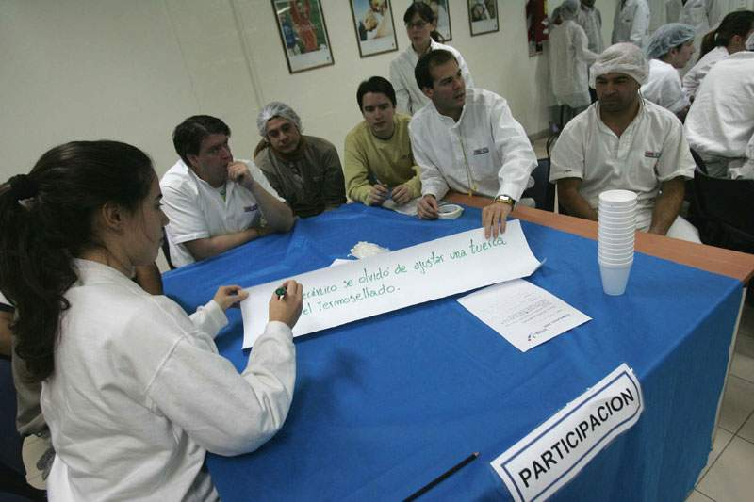
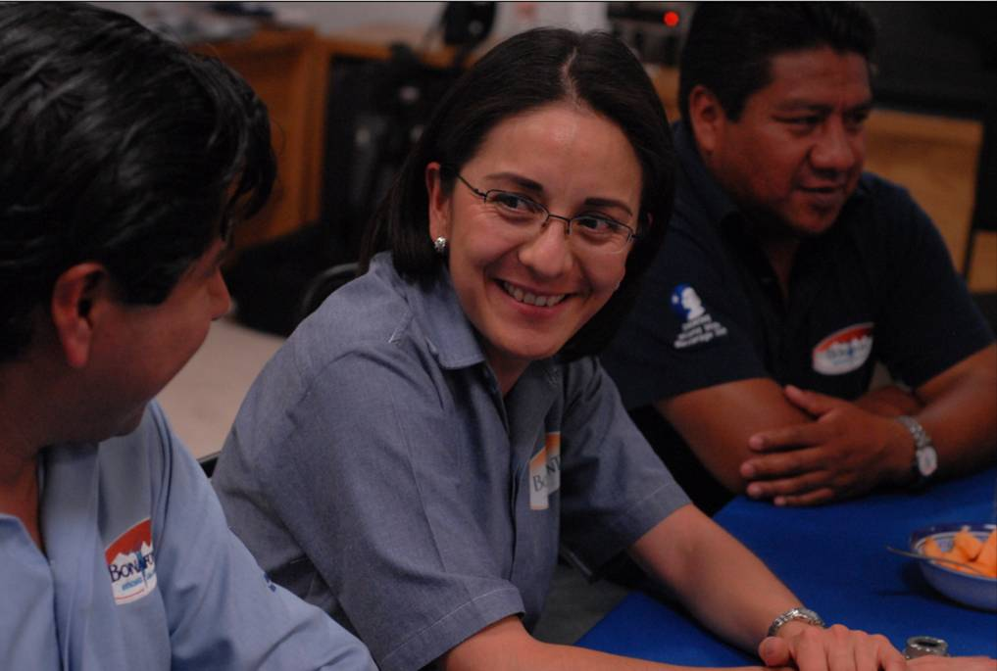
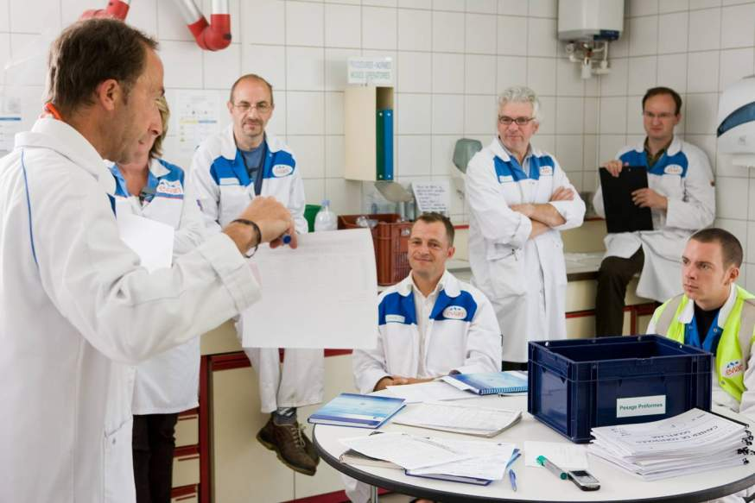
Notes:
Danone Connections was also implemented in many CBUs all over the world… it happens not only in Algeria.. Among others we have…
the Longchamps’ factory in ARGENTINA, they created “Dueños” (The Owners), a program that aims at making workers fully responsible of their workplace: The factory is divided in small areas and each Danoner is responsible of a piece. This simple mechanism brought Longchamps great results: a higher level of responsibility shown by the employees, greater sense of belonging, increase in productivity, and more.
Another very complete example are the « reuniones saludables » that are organised every month in Bonafont in MEXICO. → They last 1 hour and involve all locations at the same day. They are part of a system that has been put in place supported by the GM and HRD. Business results in Bonafont are good, DPS results too.
In Amphion FRANCE, every month a « big picture » : helicopter meeting is held with all employees. These meetings are a success thanks to proximity communication: - 92% employees have a business talk once a month
- Accidents were reduced by 38% in 3 years

Slide 54
DANONE CONNECTIONS the Internal Communication System
Notes:
So now, let’s see more in detail how it is that this Internal Communication System is structured…..

Slide 55
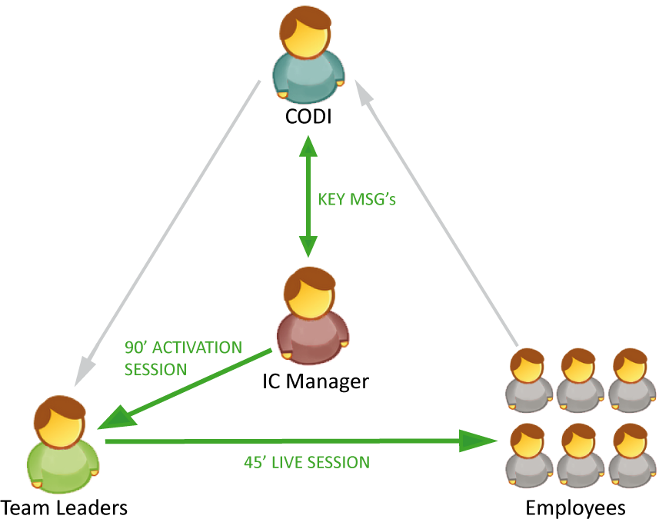
Feedback and Reactions
Notes:
This system is based on:
A committed codi who agrees to provide every month, the validated key messages they want and need employees to understand
A professional and empowered IC manager who, every month, gathers the key messages from the codi … and formalises them in the right format. Short and impactful!!
Then we have the team leaders with CODE; that have been previously coached by the IC Manager through the activation session (as we have seen with Christophe)
These team leaders organise live sessions every month. They need to understand their key role as internal spoke persons, and tools to perform this role efficiently, in 45 minutes, without being boring. Their objective is to explain key messages, to answer the questions and ultimately provide the big picture that will generate engagement
And of course it is key that employees give their feed-back which will be transmitted to IC managers and CODI

Slide 56

45’ STRUCTURE
Monthly Live Sessions
10’
on the corp & WWBU
45’ every month
20’
on CBU and/or factory
15’
Q&A
Notes:
The structure we recommend for the 45’ Live session is this chart:
In the 10 mns on the corporate (finance, news etc) and the WWBU, the baby division can of course use the PCK which will be simplified
The following 20 minutes are aimed to speak about the CBU or factory. (depending your case)
And then, I would say that the most important part of this structure is the 15’ time of feedback.
Maybe at the beginning the employees will be a bit shy and not dare to express their opinions. But once it starts to be established they will start to deeper express their concerns
** To keep the dynamics of the DC it is important the use of the material that Christophe just explained you

Slide 57
Why are we here?
We are here to help you
to improve your CBU
Internal Communication System
Notes:
With Danone Connections, we aim to improve your Communication System… it means that you are not leaving aside the information tools that you currently have and use at your CBUs.
Moreover, Danone Connections will be added value to your communication System…

Slide 58

Notes:
Danone Connections doesn’t mean that traditional information tools are no longer useful…. of course we have to keep them but…
It’s just that Danone Connections gives consistency to all of them
For instance a newsletter is important to provide information but … if given after a live session, for example, every month, it can be more impactful…
This analogy proves tries to show how even if you have the information and the tools to share it…. how can be you sure that people are aware of it? Is it reaching your audience? Are they giving sense to it?

Slide 59
Notes:
We want to pass from the role of Information specialists: by being in charge of the company, the newsletter, the intranet, emails and regular ‘information supports’
To a Proximity Communication Architects….. Working together with the CODI to get the key messages to spread to all Danoners and coaching team leaders to develop their communicational capabilities to succes in engaging their teams

Slide 60
Q & A
Q & A

Slide 61
CHRISTOPHE

Slide 62
DELIVERY IMPROVEMENT SESSION
HINTS & TRICKS
Notes:
62

Slide 63

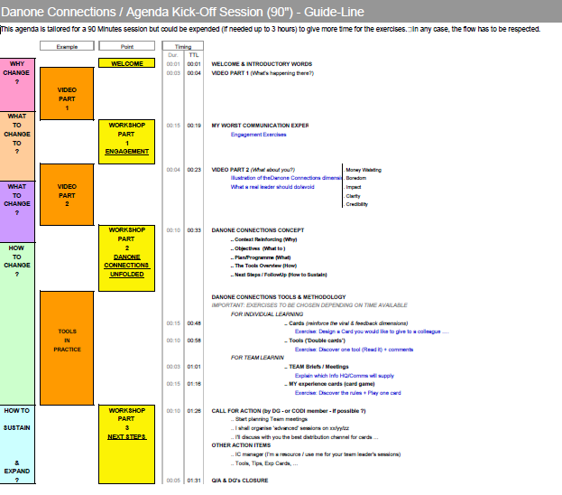
THE STRUCTURE
Notes:
63
Explain the structure
63

Slide 64
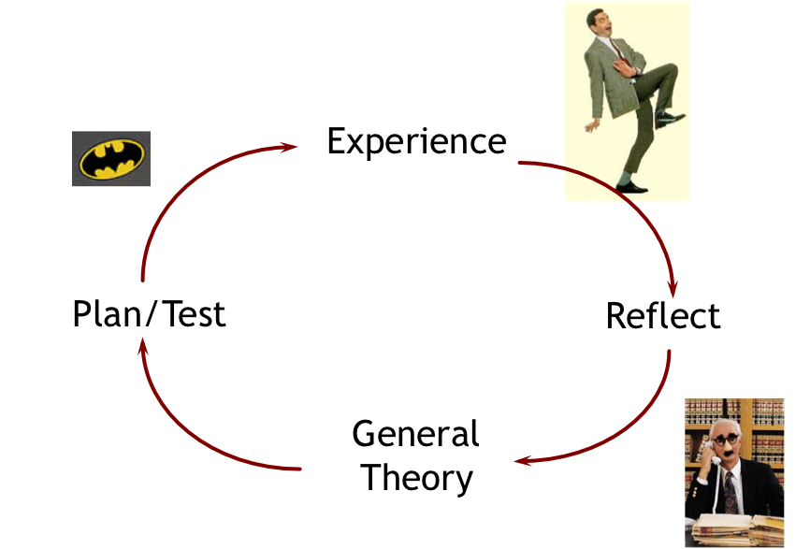
TEACHING IS NOT THE SAME AS PRESENTING
100 p
1 day
10 k Euros
10%
100 k
400,000 pots
Notes:
64
64

Slide 65
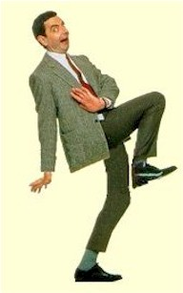


HOW DO WE LEARN?
The learning cycle
Experience
Plan/Test
Reflect
General
Theory
Notes:
65

Slide 66
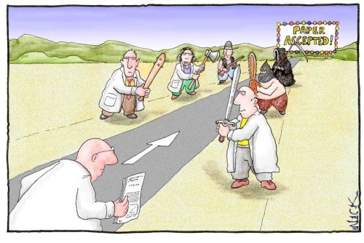
HOW TO GIVE FEEDBACK?

Slide 67

TEACHER’S BAG OF TRICKS
Looking at the content
The ingredients first

Slide 68

START WITH THE CHERRY
Start to engage
Strike from the beginning: headline news on TV

Slide 69

PEOPLE MOTIVATIONS
What do they want to hear?

Slide 70
GO FROM EXAMPLE TO POINT
E
E
E
P
P
EXAMPLE + POINT
EXAMPLE + POINT

Slide 71
STRUCTURING TO CONVINCE
EXAMPLE + POINT

Slide 72

BENEFITS
Sell the benefits not the features

Slide 76
CUT UNNECESARY WORDS
Fresh Fish Sold Here

Slide 77
5 X 5 RULE

Slide 78
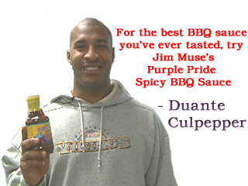
TO ADD
IMPACT
Use 3rd party endorsement

Slide 79
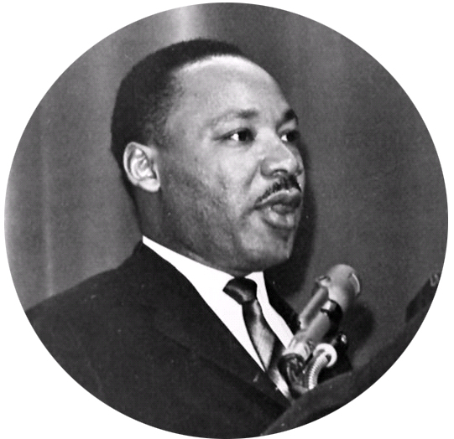
USE THE
POWER OF…
Storytelling
I have a dream today!
Notes:
79
I have a dream that my four little children will one day live in a nation where they will not be judged by the color of their skin but by the content of their character.

Slide 80

BE
CONCRETE
Always include…
a call for action!

Slide 81

THE ACID
TEST
So what?

Slide 82
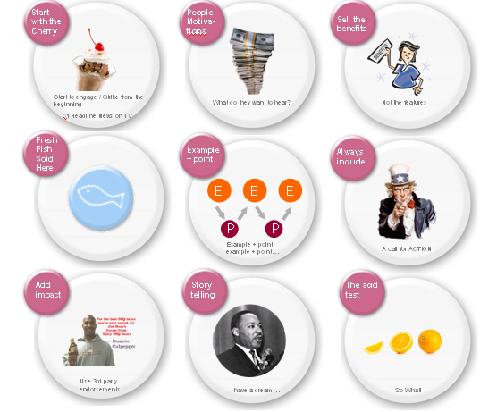
TEACHER’S BAG OF TRICKS

Slide 83

LOOKING AT INFLUENCING
Then the Chef
(Teacher/Presenter)

Slide 84
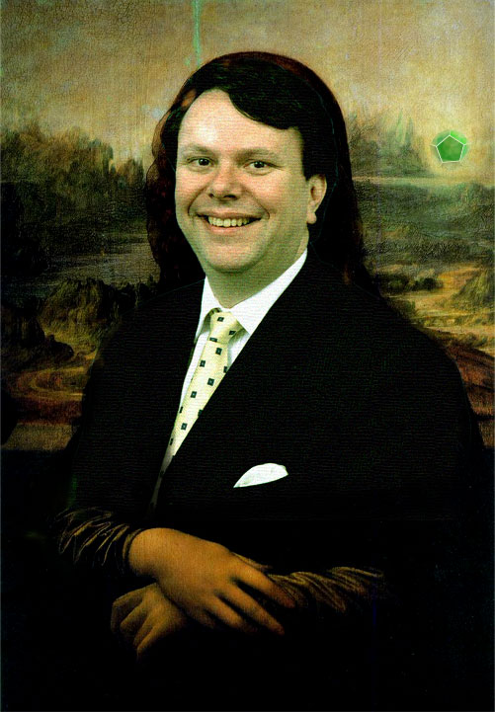
FIRST IMPRESSION
Prepare, prepare, prepare
(7 times)
You have only ONE CHANCE to make a first good impression
…

Slide 85
WHAT OTHERS THINK OF YOU
The human onion

Slide 86
HOW DO WE LEARN?
The learning cycle
Experience
Plan/Test
Reflect
General
Theory

Slide 87

ENGAGEMENT
Engage them…
no option

Slide 88
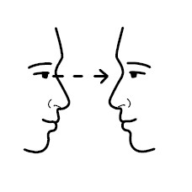
EYE CONTACT
Beginning, end and at any point of interest

Slide 89

PHYSICAL CONTACT
Check IN and OUT

Slide 90
AGENDA
PLANNING
Mood-O-Gramme

Slide 91
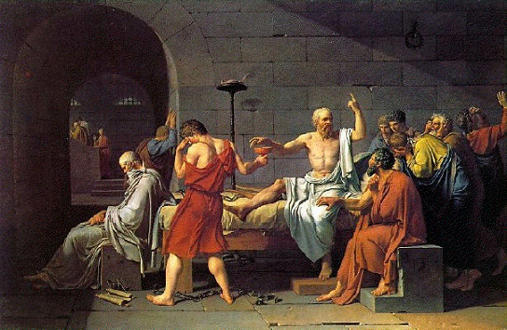
HOW TO DEMONSTRATE?
Socratic approach

Slide 92
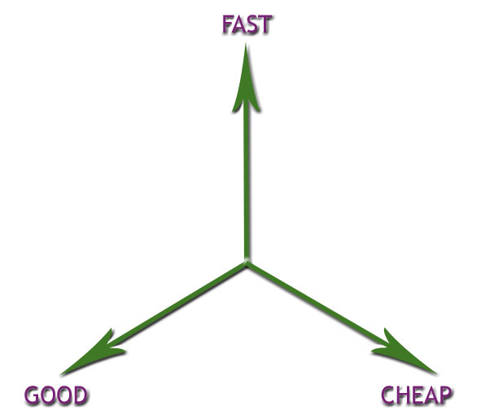
WARNING!
Do less
to do more
Quality first

Slide 93
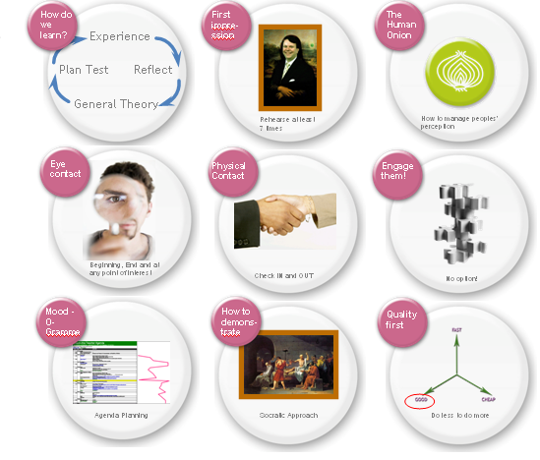
TEACHER’S BAG OF TRICKS

Slide 94
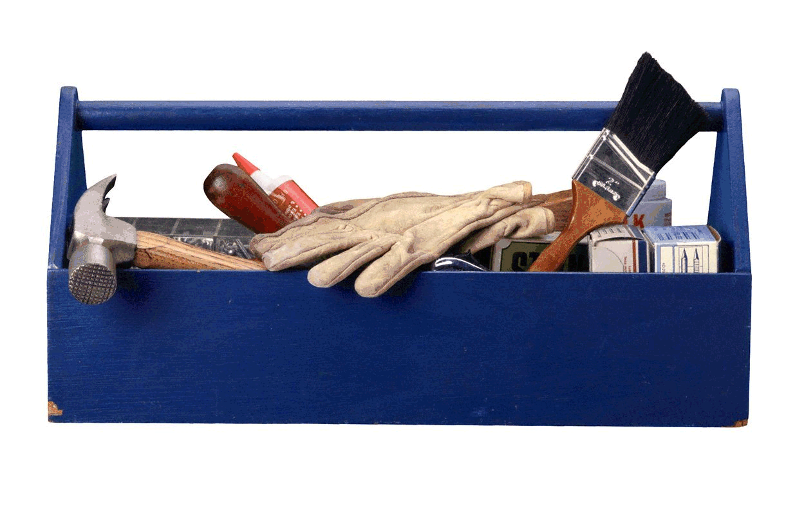
YOUR TURN
Review, adjust, adapt…
Theorize, plan to test

Slide 95
PREPARATION

Slide 96
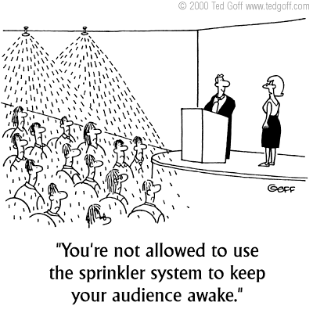
EXPERIENCE
Finally you present

Slide 97
How to create and nurture your Communication Kit
Notes:
97
CA

Slide 98
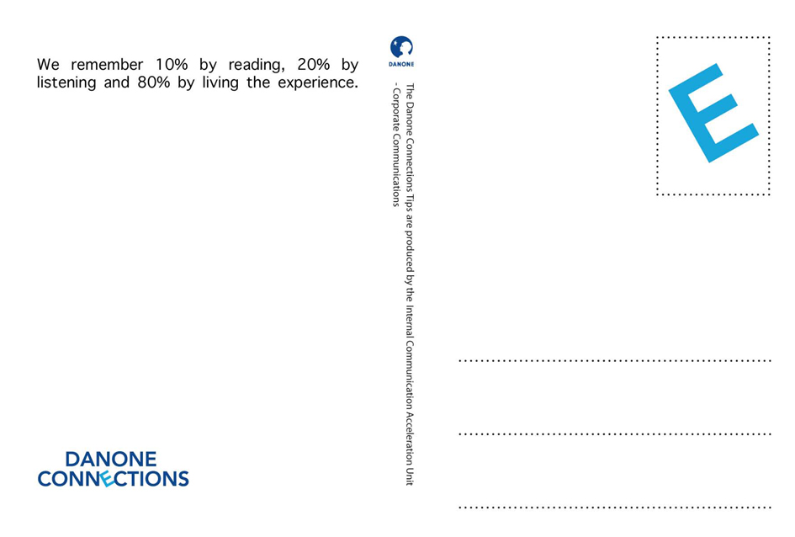

DANONE CONNECTIONS KIT
+
Communication
kit
Notes:
98
Earlier Christophe showed you the toolkit aimed at helping your team leaders communicate.
But among all the tools designed we wanted now to focus on the main support your team leaders will rely on every month to animate their Live Session : the communication kit.
This is the document that YOU will provide to your team leaders.
So what is the Communication kit and what does it consist in?

Slide 99


WHAT IS THE COM
KIT?
…………....
…………....
……….....
……….....
……….....
……….....
Every
month
PPT
Information
Confidence
Team Leader
Notes:
As I told you before, the Communicatoin Kit is the back bone of the process.
It is a Powerpoint document, summing up the key messages defined by the CODI.
It is sent every month to team leaders to help them animate their Live Sessions.
It is aimed at giving Team Leaders key information and confidence when animating Live Sessions
What does-it look like ?

Slide 100


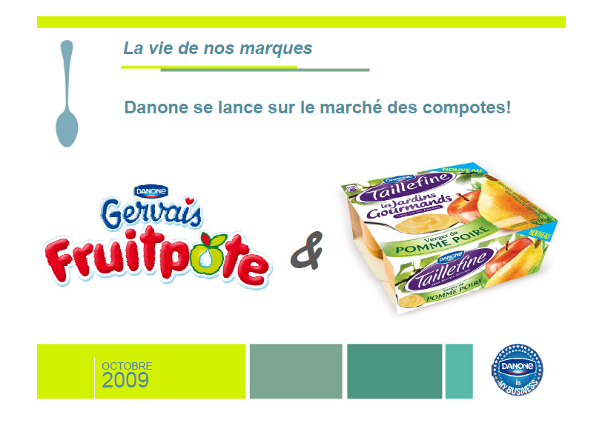
A RELEVANT
FORMAT
x
Notes:
1) It must be « presentation friendly » :
Accordingly to the tricks Christophe gave you before (fresh fish sold here : kill the useless words / 5x5 rule / don’t compete with your slides / sexy titles and impactful image)
Clear,
Spaced out,
Use all the media you may have : videos, photos, figures…
and the information has to be simple. Don’t put complicated boards, or not understandable schemes. Simplify the message in order to make Danoners understand what it means, and to make your team leaders at ease with it. Indeed, they need to feel comfortable, and to take a hold of the support.
I insist on this point because mainly, Team Leaders are not keen on communicating to their teams when they don’t have the answers. They fear being trapped and not having the answer.
2) Thus, and above all, your communication kit is not only composed of mere slides. It is completed by large speaker notes that develop the slides content.
You can also add to the Communication Kit a brief gathering Q&A. The objective is to think of the questions the Team Leaders may have and to provide in advance the answers. You can send the brief to them or organise a live brief, to present the kit and its content.
Once more it gives confidence to the Team Leaders to feel they have to key to reply to their teams.

Slide 101
A RELEVANT CONTENT
Phase 1
The process
implementation
Build your regular framework
Create your content providers network
Phase 2
The monthly
inputs
Cascade CODI key messages
Develop Q&A
Integrate corporate slides
Notes:
Now that we have tackled the format, let’s talk about the content.
2 phases are necessary to build the relevant content of your Communication kit :
The first one is the process implementation. It is a pre-phase during which you’ll define how you will manage the kit every month.
- Build your regular framework validated by CODI
- Create your content providers network
It consists in building the framework that will guide your presentation every month :
For example : the strategy / the security / the brands / Finance / Marketing / Sales… whatever drives your Business.
Once you have defined your categories, you need to find who will provide you the information each month, according to their expertise. They will form the “redaction comity” that you’ll need to extract key information and nurture your kit with useful information.
The second phase is based on the work you’ll do each month, that’s to say nurturing the kit with your content providers inputs / developing the Q&A.
In addition to that, we will provide you 4 times a year financial and corporate information that you’ll be able to integrate to your presentation.
Phase 2: the monthly input
Cascade the 3 key messages from the CODI
Develop the Q&A
Integrate the corporate slides from the HQ

Slide 102
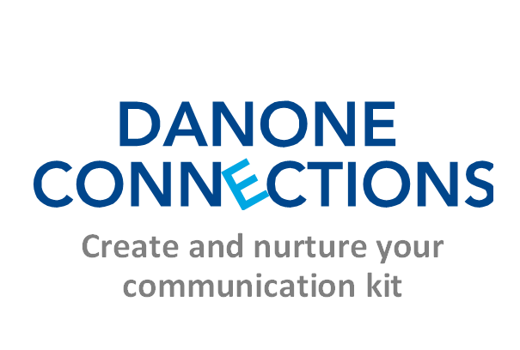
THE COM KIT STRUCTURE
3-4 slides
10’
on the corp & WWBU
45’ every month
20’
on CBU and/or factory
Q&A
15’
Q&A
8-10 slides
Speakernotes speakernotesspeakernotesspeakernotes
Q&A Q&A Q&A
Notes:
102
HOW TO STRUCTURE YOUR COMMUNICATION KIT?
Earlier Christophe showed you the structure of the Live Session which will inspire the structure of your communication kit.
The Live Session lasts around 45 ‘.
10’ are dedicated to the corporate and to your WWBU. That’s around 3-4 slides. We felt like putting it in first position but feel free to adapt the order according to your concerns.
Then 20’, the main part, are dedicated to the CBU & Factory. It’s the double, That’s to say around 8-10 slides
Finally the Q&A lasts 15’ time, to settle a real dialogue and let the team members ask questions. No slides for this part but a whole brief to give to TL in person during a “live brief” or with the kit, by e-mail.

Slide 103

KEY SUCCESS FACTOR
Make the CODI validate the framework
Notes:
It guarantees the endorsement of the CODI and their will to give you relevant information.

Slide 104

KEY SUCCESS FACTOR
Have a first version ready for the Activation Session.
Feedback
IC Mgr
TL
Notes:
Opportunity
for Team Leaders to react and
give feedback
When organising your Activation session for team leader, prepare in advance a version of what the communication is likely to look like. Present it to your team leaders, highlighting the main assets of this tool for them and ask them their feedback to adapt it to their needs.
Show them you’ll be there to support them in their task and that you care about their viewpoint to improve the communication flow, and thus their teams engagement.

Slide 105
EXERCISE
IT’S YOUR TURN NOW…
1)Create the first step of your own internal communication process : Presentation to align your CODI
2) Develop a draft of your communication kit for team leaders
Notes:
Christophe Gillet

Slide 106
ALL PREPARE
REHEARSE
PRESENT

Slide 107
DANONE CONECTIONS PROJECTS
Danone Russia – Anna GUDKOVA
Danone Hungary – Annamaria NAGY
Szabina STEHLICH
Danone Place (HQ)– Jen SMITH
Danone APMC (China) – Nancy FU
Danone Germany – Dirk GEBELL
Danone Bulgaria – Veneta STOYKOVA
Waters Poland – Katarzyna OWSIANKO
Danone Research NL– Jenny HENDRIKS
Robust China - Eva CHEN
Nutricia UK – Nicola DAVIES
Notes:
SS
We hope to have in the next months, a lot of new Danone Connections projects !

Slide 108
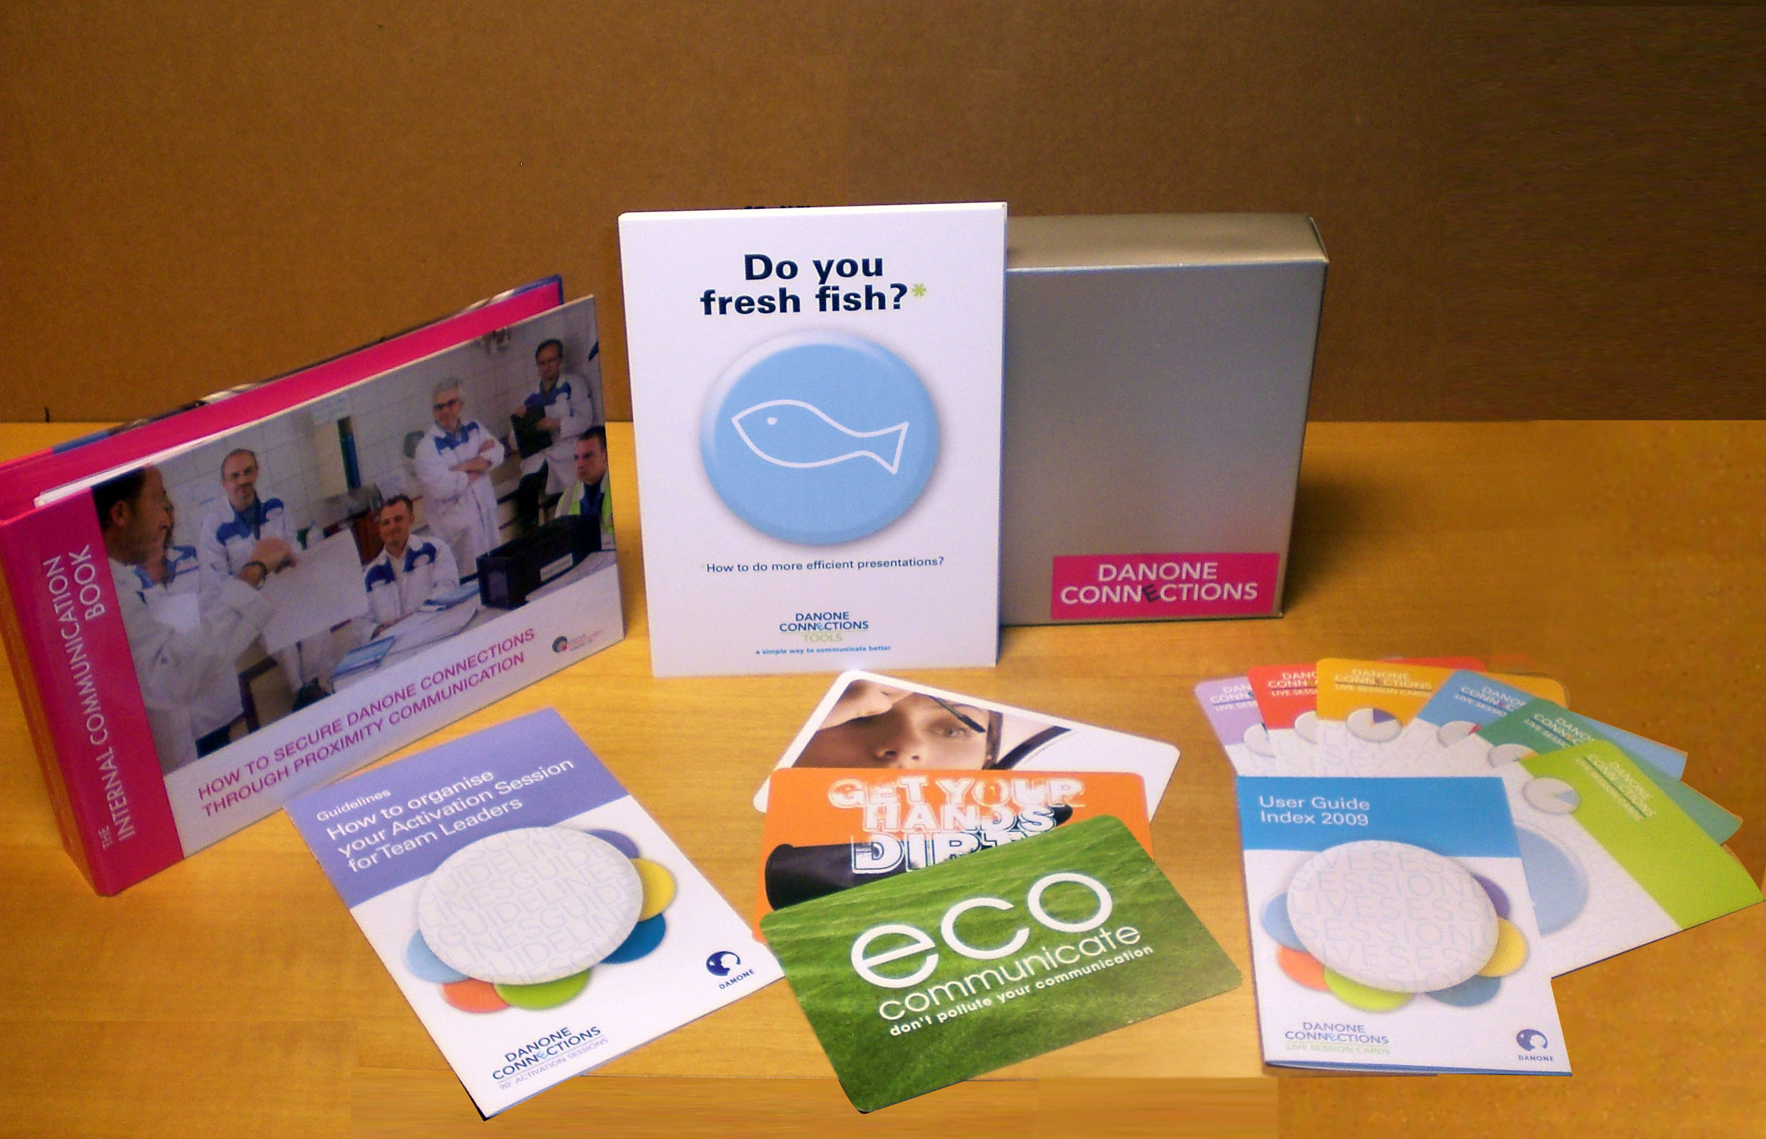
DANONE CONNECTION BOX
Notes:
SS
Now we’ll give each one of you a box, containing the tools we have presented you during the last two days.
I’d like also to attract your attention on a leaflet, recently designed that you can use like a to-do list to organise your Activation Session. It gathers what to keep in mind in order to make of it a success.
You’ll also find what we call “the IC Book”. You will find IC Managers profiles, good practices, and contacts to help you in your daily work.

Slide 109
End of
Today’s session
Let’s meet at the Millenium Hotel!
7.30 pm
(10-15 min by walking)
(Tomorrow we’ll start at 8:30 a.m. at Salle Carasso, Danone Place)

Slide 110
DAY 3
8:30-14:00
Speaker (Maire?) to include

Slide 111
Internal Communication Training
Paris, February 10th-12th, 2010

Slide 112
WELCOME
Welcome back to the
Internal Communication Training
Notes:
CG
Répétition par groupe de 2

Slide 113
AGENDA
TODAY
End of the exercise
The deal between us & you
Sticky steps
Q&A
Your career (Caroline Carle, HR)
Lunch with Laurent Sacchi
Notes:
Here is what we’re going to do today:
First, we’ll let you time to finish the exercise started yesterday, let you share your presentations, ask tricky questions…
The deal between you and us that will rule our collaboration over the next months
Sticky steps : your engagement towards Danone Connections Process and the next steps you’ll take in your CBU
Then your career path with Caroline
Finally Laurent will give you his vision on IC

Slide 114
PAUSE
Pause
15 minutes

Slide 115

The Deal
By Sabrina Schneider

Slide 116
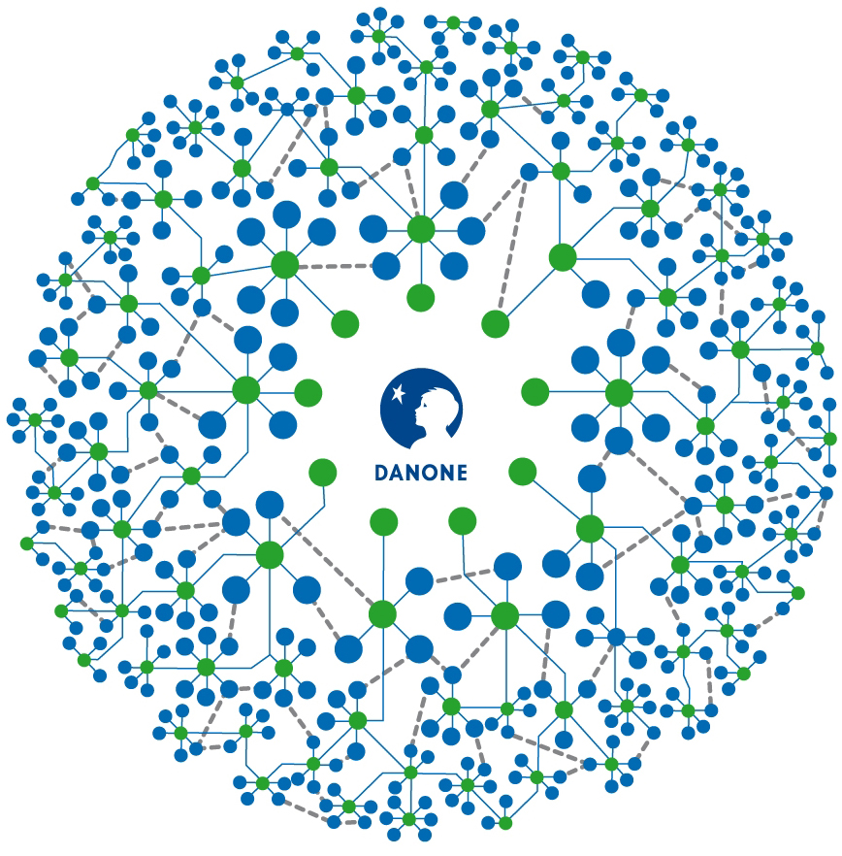
Internal communication A.U.: What for ?
Stay connected !
Notes:
116
I would compare our IC community to a close family, good family doesn’t see eachother only at christmas lunch, they also call each other, they meet on one-t-one, it is quite the same with us. We have phone call, a seminar, webconference, etc…
We’ve talked about engagement for the last 2 days, we started or reinforced a relationship together, let’s stay connected and for that I propose you to make a deal between you and us

Slide 117



The Internal Communication A.U. : a deal between us
What we could offer you ? And what you could give us ?
CONNECTIONS
CAREER
INFORMATION
TOOLS
GLORY
Notes:
Here what we could offer you and in return what you could give us !

Slide 118
The Internal Communication A.U. : a deal between us
What we could offer you ? And what you could give us ?
CONNECTIONS
CAREER
INFORMATION
TOOLS
GLORY

Slide 119
YOU
Succes stories, Live sessions slideshow, issues
US
Financial results, Corporate press releases, Contents for Live sessions
INFORMATION
Notes:
Information that you already received from the Corporate.
Now we are going to post all those information in the IC HUB, our community intranet which will be launched in a few weeks.

Slide 120
The Internal Communication A.U. : a deal between us
What we could offer you ? And what you could give us ?
CONNECTIONS
CAREER
INFORMATION
TOOLS
GLORY

Slide 121
CONNECTIONS
US Phonecalls, emails
Webconf, Meetings, visits
YOU Capillarity,
Impact through your local network
Notes:
Build and animate your own local network to maintain your IC system and to give us some capillarity
Be the Danone ambassador through your own network

Slide 122
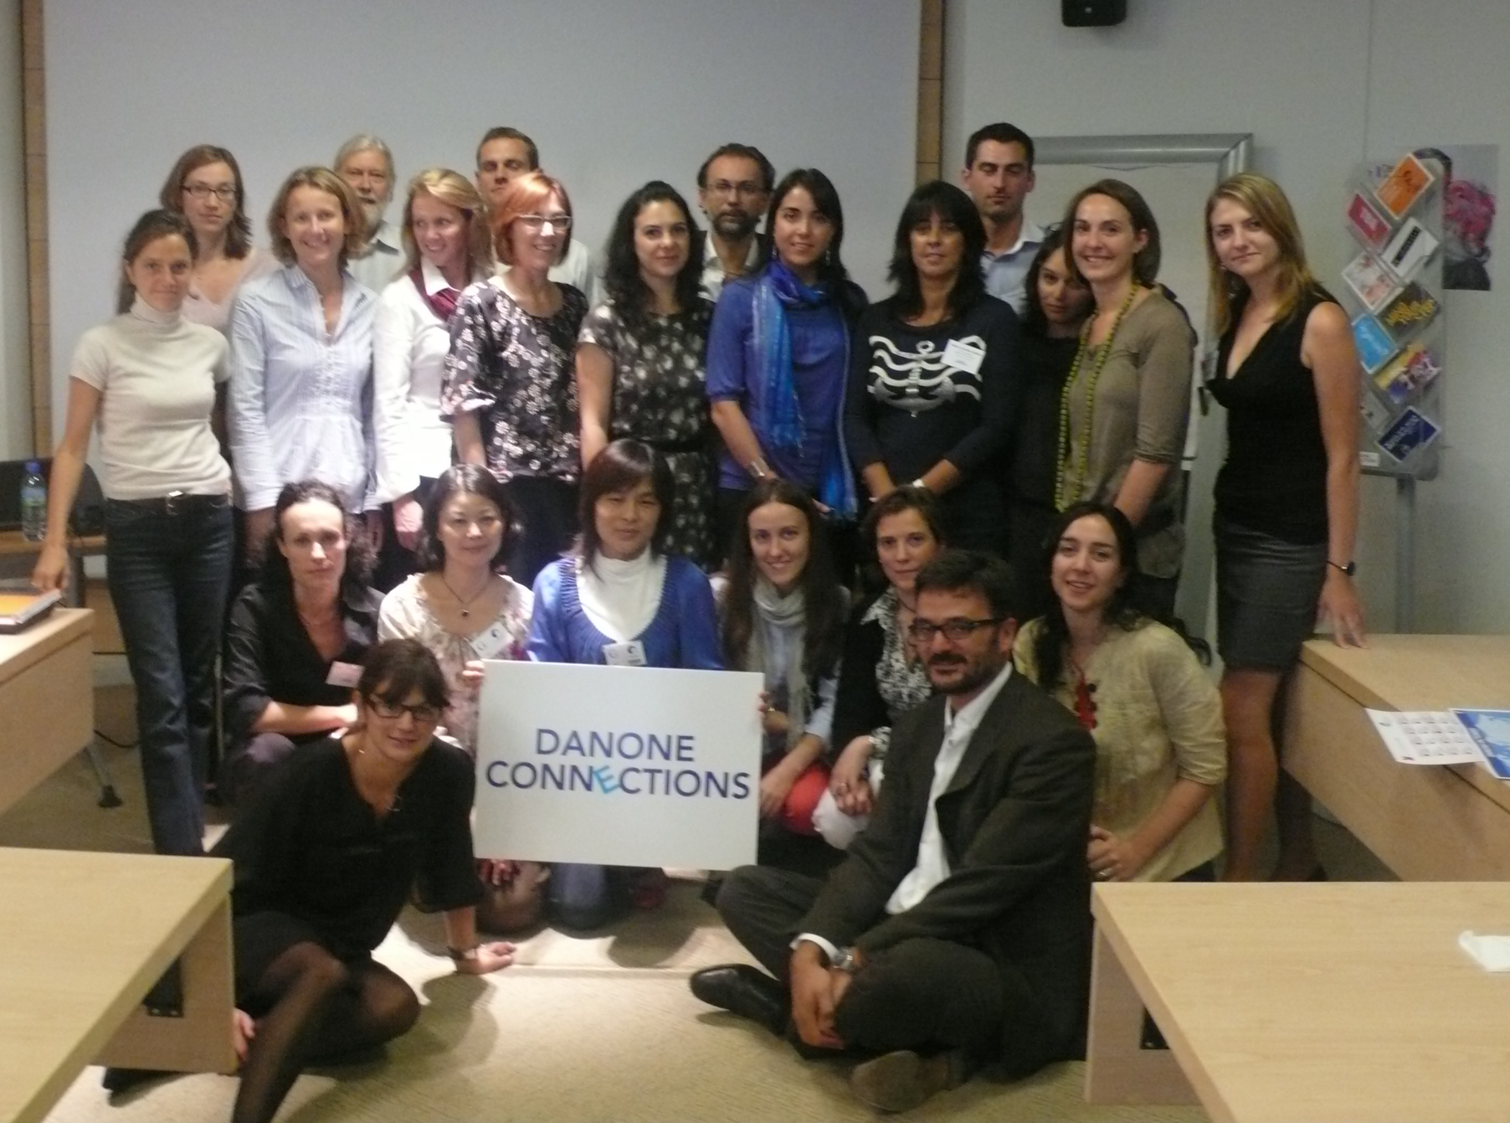
Notes:
PICTURE OF PREVIOUS DANONE CONNECTIONS MEETING

Slide 123
The Internal Communication A.U. : a deal between us
What we could offer you ? And what you could give us ?
CONNECTIONS
CAREER
INFORMATION
TOOLS
GLORY

Slide 124
TOOLS
US
Videos, Methodology, IC network poster, D. Connections tools, IC HUB
YOU
Tested and improved tools in your CBU
Notes:
We have a live example today with Danone Connections box.
We count on you to organize as soon as possible Live sessions in your CBU or to improve your existent IC system.

Slide 125


Strategic axis,
Corp&finance
Network
details
Good
practices
Toolbox
Stay connected !
Notes:
CA
Aim of the IC HUB :
Nurture the IC Community and to provide information and tools to help you in your job
Don’t hesitate to give us your feedback on things you’d like to see in the HUB, categories, posts…
The hub is composed of 5 main parts :
Streams and Corp&financial news : everything related to the streams to give an esay access to them / the latest press realeases / the results…
Toolbox : download ready to use tools. They are classified per projet/program…Feel free to use them, or to adapt them, to translate etc…
Good practices box : action plans set up by CBUs all over the world, on the current projects/programs that Danone has. Example : CODE@Danone Place Paris / Health@work @ Danone Research / Credibility program on brands with health benefits @ Danone Spain… and others will come.
Network details : rely on the IC community poster for which all of you gave us your picture. It can be dowloaded in high definition and you’ll find there pic / position / CBU / links to the who’s who and to send them mails directly.

Slide 126
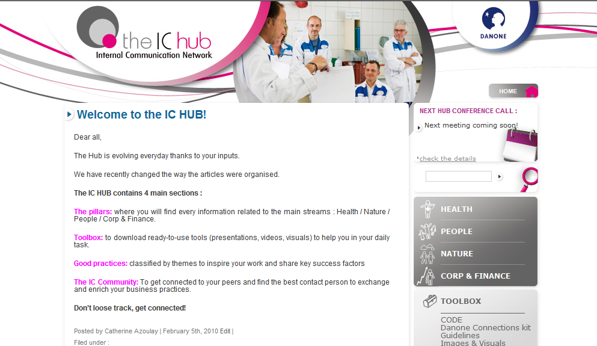
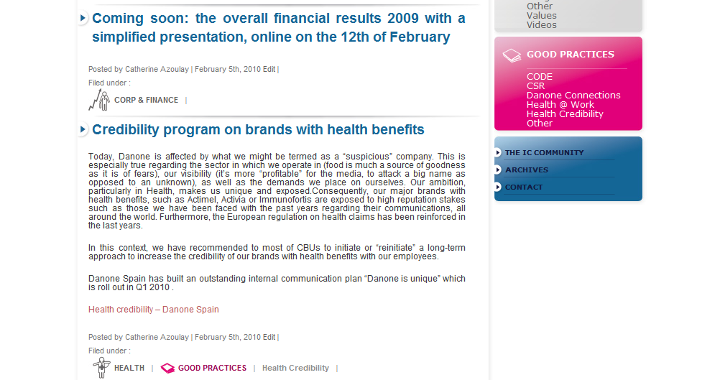

Slide 127
The Internal Communication A.U. : a deal between us
What we could offer you ? And what you could give us ?
CONNECTIONS
CAREER
INFORMATION
TOOLS
GLORY

Slide 128
GLORY
YOU
Through your success stories
US
Visibility on corporate medias and through the IC community
Notes:
Your nice stories: published on e-managers
shared with the IC community on the IC HUB
Used in corporate video for GM meeting in Evian or other important meetings

Slide 129
The Internal Communication A.U. : a deal between us
What we could offer you ? And what you could give us ?
CONNECTIONS
CAREER
INFORMATION
TOOLS
GLORY

Slide 130
CAREER
YOU
Through your career improvement
US
HR developpement
Notes:
We will start today to offer you some details on HR developpement in Communication career paths with Caroline CARLE later.
She is HR manager at Danone Place, among other, she in charge of Communication function.

Slide 131




The Deal: calendar
 | Jan. | Feb. | Mar. | April | May | June | July | Aug. | Sept. | Oct. | Nov. | Dec.
1st Quarter Sales & results
3rd Quarter Sales & results
Financial results
Final results
1st Half Sales & results
Shareholder’s meeting
Good practices & tool box
IC HUB
Confcall one-to-one
1 - 2/ yr
NOG & Corp. PR
INTERNAL COMMUNICATION EMAILS
Webconf on specific topics
Updated network poster
2010 DWC INTRANET
Notes:
131
Then as you can see on this calendar, we’ll be connected all the time !

Slide 132
My commitment
Sticky steps
Notes:
CG

Slide 133
Q&A
Any questions ?

Slide 134
Communications Careers
Competencies and career paths within the communication function
Caroline CARLE
HR manager,
Danone Place, Paris
Notes:
I don’t need to introduce Caroline as you all met her yesterday at lunch.
Caroline, thank you to be with us today.

Slide 135
LUNCH
Lunch with
Laurent SACCHI
VP Communication

Slide 136
Conclusion & Farewell
Notes:
Static slide

Slide 137
What’s
next?

Slide 138
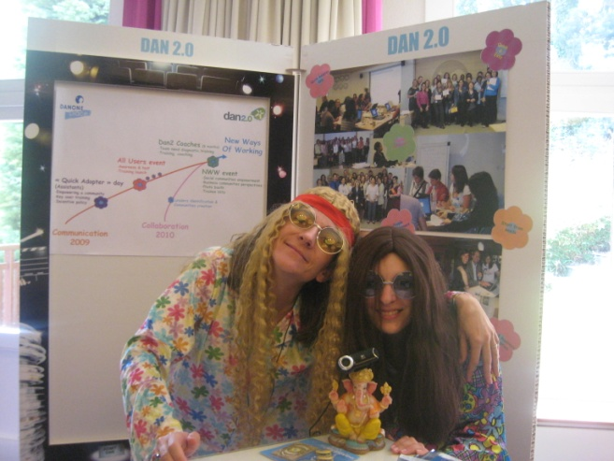
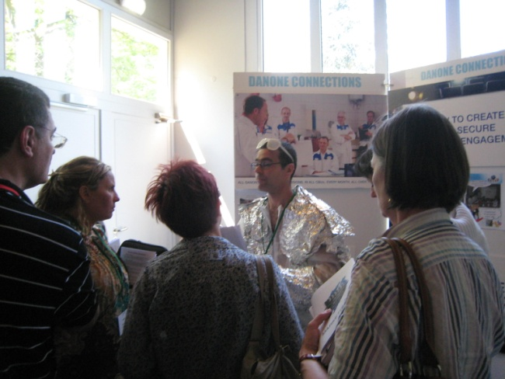

Danone Connections is for you!
Notes:
**Photo du market place**. I came here for you to share our vision.
I believe that, as a contributor to achieve the **phoenix code etc *** this tool is simple and concrete : DC
Connecting people

Slide 139

Q & A
Thank you !!

